Slide 1

University of Pretoria
THE STATE OF DOMESTIC TOURISM IN SOUTH AFRICA: CHALLENGES AND OPPORTUNITIES
30 March 2015
Prof Berendien Lubbe
Division: Tourism Management
berendien.lubbe@up.ac.za

Slide 2

Overview
What domestic tourism is
Why it is important
How we are performing
How we compare
How we travel
Our challenges
Our opportunities

Slide 3
What is domestic tourism?
Domestic Tourism
The tourism of resident visitors within the economic territory of the country of reference (StatsSA).
Domestic Tourist
  Residents of one country travelling only within that country,
    Outside usual environment
    Not remunerated within the place visited
Domestic Travel & Tourism Spending –
Spending within a country by that country’s residents for both business and leisure trips

Slide 4
Why is domestic tourism important?
Cushions effect of global market volatility, bringing stability & predictability in the industry
Lessens troughs in seasonality
Keeps spending money within home country
Geographic spread of tourists beyond main city areas
Year-round economic growth
Increased employment (direct and indirect) - poverty alleviation
Tourism culture creates responsibility for tourism protection within local communities
Generation of pride and ambassadorship for country
Not as vulnerable to problems arising from international airline schedules, changing international tastes, perceived security threats
Greater loyalty towards destination
(Butler, 2012; Okello et al., 2012; Mendiratha, 2011; Cornellisen, 2005; Rogerson & Lisa; 2005)

Slide 5
How are we doing?
Source: WTTC, 2015

Slide 6
How do we compare?
Source: WTTC, 2015

Slide 7
How do we travel?
Key Metrics |  | 2007 | 2008 | 2009 | 2010 | 2011 | 2012 | 2013
Number of Trips | Annual | 35,9 Million | 32,9 Million | 30,3 Million | 29,7 Million | 26.4 Million | 25,4 Million | 25,2 Million
 | By purpose | VFR: 68%, Holiday: 56%, Business: 7%, Religious: 7%, Medical: 1 % | VFR: 71%, Holiday: 16%, Business: 5%, Religious: 5%, Medical: 2 % | VFR: 76%, Holiday: 12%, Business: 5%, Religious: 5%, Medical: 1 % | VFR: 74%, Holiday: 13%, Business: 5%, Religious: 6%, Medical: 1 % | VFR: 73%, Holiday: 15%, Business: 5%, Religious: 6%, Medical: 1 % | VFR: 72%, Holiday: 12%, Business: 5%, Religious: 8%, Medical: 1 % | VFR: 70%, Holiday: 12%, Business: 8%, Religious: 7%, Medical: 1 %
Spend | Total Annual spend | R 20.0 Billion | R25,8 Billion | R28,8 Billion | R21,1 Billion | R20,2 Billion | R 21,8 Billion | R24,3 Billion
 | By purpose | VFR: 45%, Holiday: 37%, Business: 14%, Religious: 3%, Medical: 0 % | VFR: 45%, Holiday: 39%, Business: 12%, Religious: 3%, Medical: 2 % | VFR: 59%, Holiday: 22%, Business: 17%, Religious: 2%, Medical: 1 % | VFR: 51%, Holiday: 31%, Business: 14%, Religious: 3%, Medical: 0% | VFR: 51%, Holiday: 31%, Business: 14% Religious: n/a, Medical: n/a% | VFR: 52%, Holiday: 23%, Business: 17%, Religious: n/a%, Medical: n/a% | VFR: 47%, Holiday: 26%, Business: 19%, Religious: n/a, Medical: n/a%
 | Average Spend per Trip | R550/ Trip | R780/Trip | R730/Trip | R710/Trip | R780/Trip | R850/Trip | R980/Trip
(Source: SA Tourism; Statssa)

Slide 8
Percentage spend on most recent overnight trips by population group at province of destination, Jan – Dec 2013
Source: StatsSA Domestic Tourism Survey, 2013

Slide 9
What are our challenges?
Research focus
Economic impediments
  Affordability
  Loss of income – informal sector)
Social impediments
  Lack of knowledge
  Lack of awareness of activities (e.g. KNP)
  Socialisation patterns (Butler, 2012)
  Lack feeling of “belonging” in many recreational spaces
Tourism capacity at local government level
Limited resources in domestic tourism
Infrastructure capacity
  Matching supply and demand in all regions

Slide 10
Are we using our opportunities?
We have gained recognition…………
China
  South Africa (DTGS)
During 2009 Recession
  Tourism authorities launched series of stimulus plans to boost domestic tourism
    Promotion of rural tourism & tourism coupons
Introduction of “Golden Weeks”
  National days & Festivals
“Tourism belongs to all“
  Stimulate a tourism culture (SAT)
    Sho’t Left campaign
    First-time travellers FAQ (SAT)
    “Fun Bus”
  Industry innovations for new travellers
    Tour Operator packages
(Mendiratta, 2011; Rogerson & Lisa, 2005; Lang, liu & Ki, 2013 )

Slide 11
……but we can always do more
Recognise the value of the “Diaspora” VFR market?
    Adding the “Diaspora tourist” as sub-segment of domestic tourism (Scheyvens, 2007)
    Nationals from a country who live overseas - the diaspora – but who return home for short holidays (same characteristics as the domestic tourist):
      Tendency to travel to places that foreign tourists do not go
      Attend important social and cultural events
      Distinct from international visitors
      Can make significant contributions to development of their country

Slide 12
Match tourism supply & demand –
  One size fits all is not the solution – Recognise that:
  Domestic market segments have different needs
  Product offerings in different regions meets these needs to a greater or lesser extent
  Each tourism region (stakeholders) should cohesively develop their product offerings to meet the needs of the different market segments

Slide 13
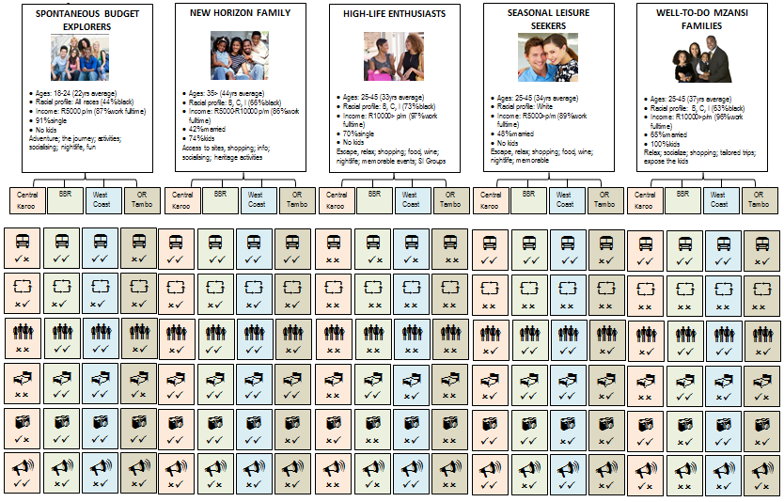
Match Model (2013)
Notes:
45, 3 excluded: Zimbabwe, Somalia and Liberia. 12 factors were identified, but time invariant factors had were omitted as they displayed no variation over an 11 year time period as they had no power to predict variation in traffic: colony, border, distance, language, partner and reporter islands. Previous studies that tested them were all cross-sectional. Air passenger traffic flows are not only dependent on aviation policies and elements of the BASAs, other factors also play a role, inter alia, the size of the GDP, population size, magnitude of the services trade flows; the quantitative phases aimed at identifying which specific provisions of BASAs have the most significant impact on air passenger traffic flows.
A number of years since the first bilateral was enforced. This variable was incorporated following Piermartini and Rosouva’s (2008) and (2009) approach. Attempts to account for the effective implementation of an agreement. The product of the per capita GDP for the two countries on either side of the route (data are in current US dollars), which measures the magnitude of economic activity of a nation, positive partial impact as the propensity to fly will likely to disproportionately increase with the level of income Most research concludes that traffic growth faster than the GDP. A dummy variable equal to “1” indicates that one and only one country in the country-pair is a low-income country. This variable was introduced to capture the relatively low attractiveness of low income countries for passengers from other countries (Piermartini & Rousova, 2008). Services flows. Service activities usually require a close interaction between the seller and the consumer, so that the sale of services is an important determinant of the demand for travel as the relations increase the need for face-to-face communication (InterVISTAS-EU Consulting, Inc., 2009). It was not possible to obtain data on services trade data for each potential country-pair. Following the approach of InterVISTAS-ga² Consulting, Inc. (2006) and InterVISTAS-EU Consulting, Inc. (2009) the model utilises a gravity-type relationship between each nations’ services trade with all countries to define a country-pair propensity. The service flows of trade are expressed as: (exports of services by country A x imports of services by country B) + (exports of services by country B x imports of services by country A). Data are in current US dollars. Product of the population on either side. Traffic has been defined as the yearly two-way origin-destination traffic between the country-pair low-income country – partial negative impact, while all other variables remain constant

Slide 14
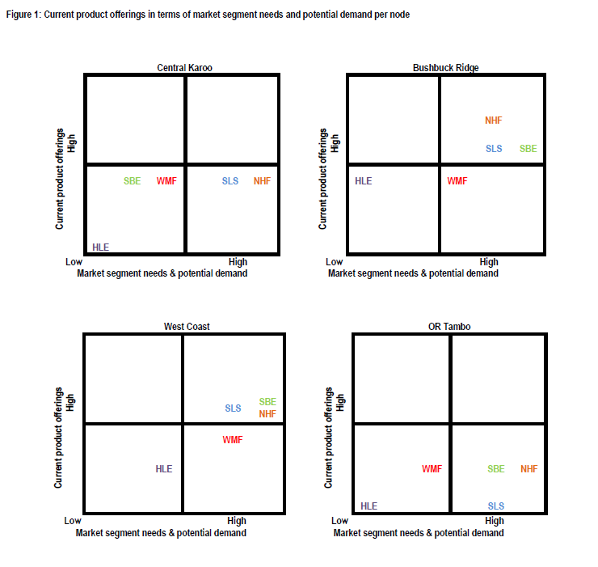

Slide 15
  “…leisure travel is no longer….the exclusive prerogative of the upper classes..…it extends beyond the growing middle class to include the participation in leisure travel of the lower middle classes.”
  (Rogerson & Lisa, 2007:91)

Slide 16
Thank you

